Slide 1
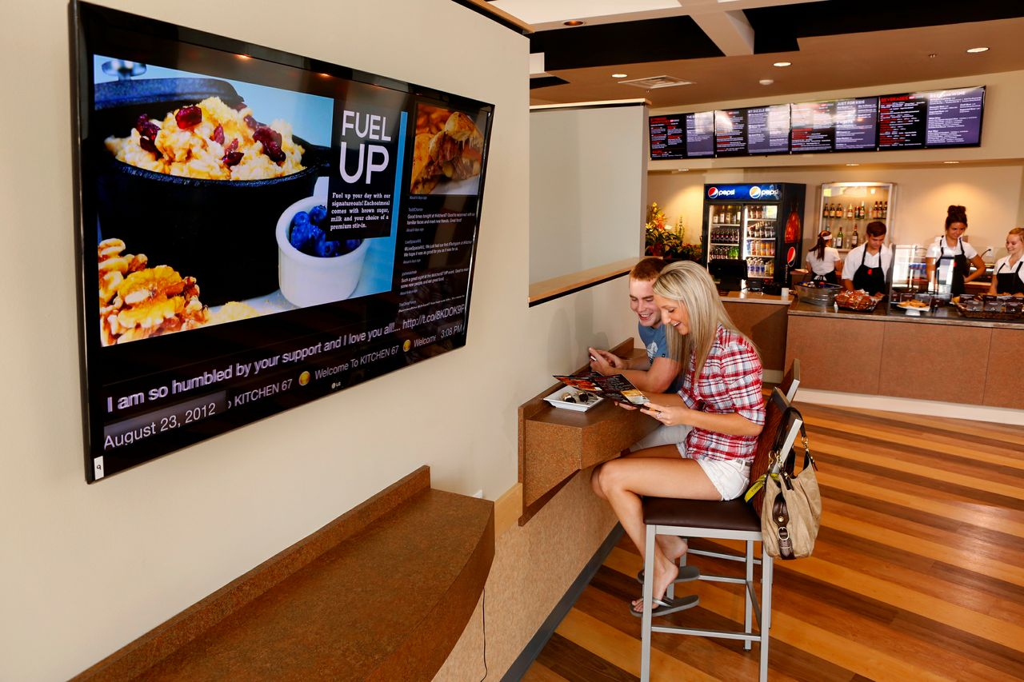
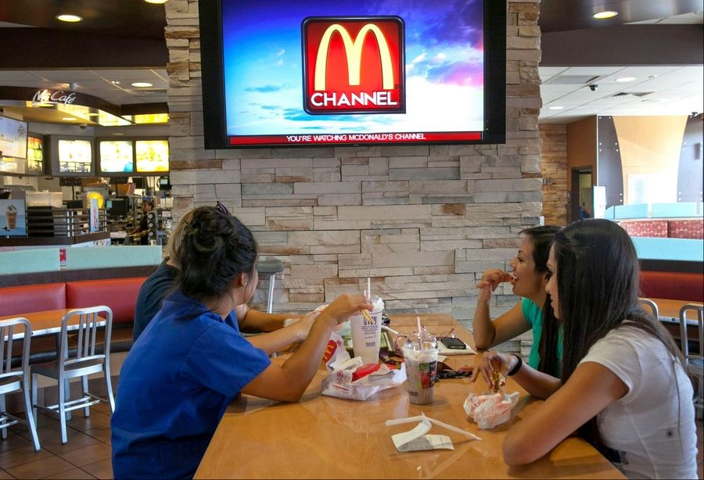
Join the network for FREE and earn up to 80% in Sales Commission!
Like Electronic Billboards on the Highway, Indoor Digital Billboards are designed to display Ads randomly while guests are waiting in a place of business.
Get your own channel on Billboard TV Network!
For More Info Call BTV at 717-467-1010 or BillboardTVNetwork.com

Slide 2
Advertise directly to target audiences where they shop!
Like Electronic Billboards on the Highway, Indoor Digital Billboards are designed to display Ads randomly while guests are waiting in a place of business.
Advertise on a Billboard TV Network in your area for $50 a month!
For More Info Call BTV at 717-467-1010 or BillboardTVNetwork.com

